Slide 1
SMART ANTENNA FOR BRAIN TUMOR APPLICATION
By
Balaji.R
201502018
Balaji.V
201502019
Bhuvanesh.G
201502022
UNDER THE GUIDANCE OF
Mr.A.Karunakaran, M.E.,
Asst.Prof,
ECE, Dept.,

Slide 2
Introduction
In Microwave imaging, the antenna is the key element for connection between the head and the back end of the microwave imaging system.
The dimension and radiation characteristics of the antenna control the overall microwave imaging performance greatly.
To be portable and at the same time have all the characteristics desired by the microwave imaging system is a challenging task specifically when it comes to the most sensitive part of human body (head).
The final structure achieves a constant gain of 6.6 dB throughout the frequency ranging from 2.65– 2.91 GHz.

Slide 3
Objective
To sense the radiation detected tumour affection on a particular part of the body (head).
Due to its body wearing idea of these type devices these devices should be made upon low radiating towards the body because of tissue affection on the body.
Here a body wearable microwave antenna is made to analyse the radiation over the body.
It is analysed and detected in the combination of the microwave analysis

Slide 4
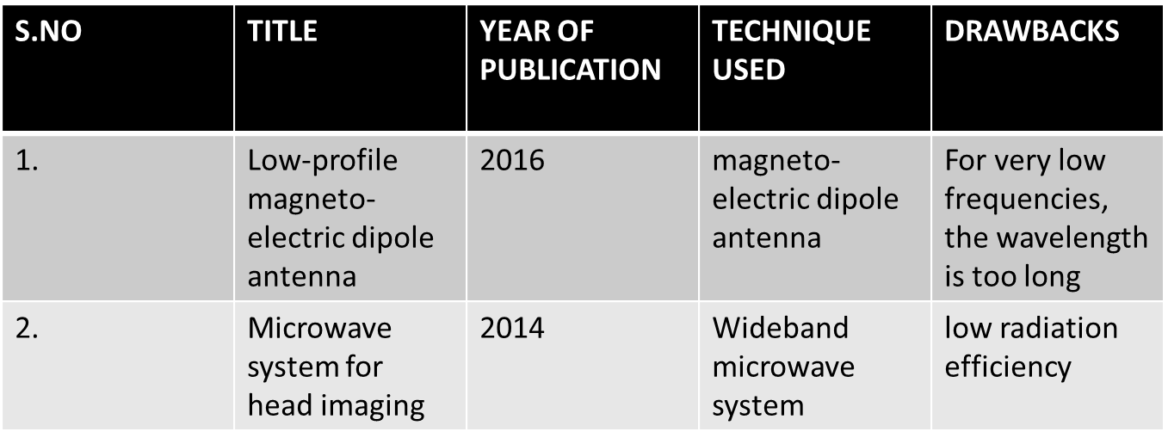
Literature Review

Slide 5
Existing Model
The CT and MRI scanners are typically large, box-like machine with a hole, or short tunnel, in the centre.
Rotating around you, the x-ray tube and electronic x-ray detectors are located opposite each other in a ring, called a gantry.
The computer workstation that processes the imaging information is located in a separate control room, where the technologist operates the scanner and monitors your examination in direct visual contact and usually with the ability to hear and talk to you with the use of a speaker and microphone.

Slide 6
Proposed Model
Tumour analysis on the head using CT and MRI scanning systems.

Slide 7
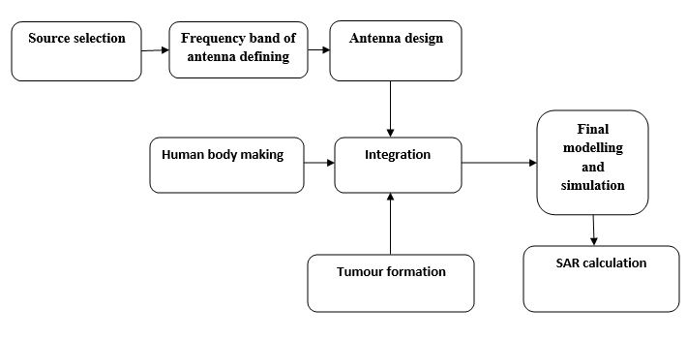
Block Diagram

Slide 8
Experimental results and discussion
Tabulate the experimental result and write the inference
Results and discussion part should focus on the results you have claimed as the special feature of your project.

Slide 9
Conclusion
Hence the proposed method for detecting brain tumor using Specfic Absorbtion Rate (SAR) of low frequency, unidirectional, high gain, Dielectric resonator antenna (DRA) with 3-D structure is reported to have a wide bandwidth spectrum.

Slide 10
References
[1] B. J. Mohammed, A. M. Abbosh, S. Mustafa, and D. Ireland, "Microwave system for head imaging," Instrumentation and Measurement, IEEE Transactions on, vol. 63, pp. 117-123, 2014.
[2] o. N.-I. R. H. IEEE Standards Coordinating Committee 28, IEEE Standard for Safety Levels with Respect to Human Exposure to Radio Frequency Electromagnetic Fields, 3kHz to 300 GHz: Institute of Electrical and Electonics Engineers, Incorporated, 1992.
[3] A. Sabouni and A. Kishk, "Dual-polarized, broadside, thin dielectric resonator antenna for microwave imaging," Antennas and Wireless Propagation Letters, IEEE, vol. 12, pp. 380-383, 2013.
[4] A. T. Mobashsher, A. M. Abbosh, and Y. Wang, "Microwave system to detect traumatic brain injuries using compact unidirectional antenna and wideband transceiver with verification on realistic head phantom," Microwave Theory and Techniques, IEEE Transactions on, vol. 62, pp. 1826-1836, 2014.
[5] X. Li, M. Jalilvand, Y. L. Sit, and T. Zwick, "A compact double-layer onbody matched bowtie antenna for medical diagnosis," Antennas and Propagation, IEEE Transactions on, vol. 62, pp. 1808-1816, 2014.

Slide 11
Thank You

